Slide 1

Project Name: AI-Enabled Appointment Scheduling and Service Management System
Name: Divya Davra
Date: 4/12/2025

Slide 2
Introduction
Industry: Beauty & Wellness (Salons, Spas, Wellness Centers)
Problem: Manual bookings, disconnected data, no real-time insights
Solution: Smart, centralized system using Power Apps + SQL Server + Power BI
Approach: Low-code, AI-enhanced solution for appointments, orders, and payments
Key Features:
Online booking & order management
Role-based login
Multi-mode payments (Cash, Card, Check)
Real-time dashboards & analytics
Outcome: Improved operational flow, enhanced user experience, and data-driven decisions
Notes:
This industry includes salons, spas, and wellness centers where efficient customer service and scheduling are crucial. However, many small to mid-sized businesses still rely on manual methods, leading to double bookings, disconnected systems, and a lack of real-time data insights.
To address this, I developed a smart, centralized system using Microsoft Power Apps, SQL Server, and Power BI. The solution is built on a low-code platform, making it scalable, secure, and easy to maintain.
Some of the core features include:
Online appointment booking and service ordering
Role-based login for customers and staff
Multi-mode payment options like cash, credit card, and check
And most importantly, AI-enhanced analytics for peak-hour predictions and service recommendations.

Slide 3
Industry & Problem Context
1. Industry Description:
Personal care businesses like salons rely on efficient scheduling, payments, and analytics.
2. Business Problems:
Manual bookings
No AI personalization
Lack of real-time insights
Disconnected systems
Notes:
First, the Industry Description: This system is designed for the beauty and wellness industry, which includes salons, spas, and wellness centers. These businesses rely heavily on timely service, personalized care, and efficient scheduling. However, many small and mid-sized salons still use manual or disconnected tools for managing customer appointments, service records, and payments.
Now, the Business Problems: The main issues faced by these businesses include:
Manual booking processes, which often result in double-bookings or missed appointments.
Disorganized data across multiple tools or paper systems, causing delays and poor customer service.
A lack of real-time insights into appointments, staff performance, and revenue trends.
No intelligent recommendations to suggest services based on a customer’s history.
And insufficient data security and role-based access, especially where sensitive customer information is involved.

Slide 4
Organizational Sponsors
Customer – books appointments
Staff – manages orders
Admin – reviews dashboard/analytics
Notes:
🔸 First, we have the Customer – they are the end-users of the salon who can book appointments, place service orders, and make payments directly through the app. The interface is built to be simple and mobile-friendly for quick access.
🔸 Next is the Staff – they manage customer appointments and service orders. Staff can view bookings, update order statuses, and ensure everything is ready for the day.
🔸 Lastly, the Admin, which would typically be the salon owner or manager. They use the Power BI dashboard to monitor business performance – like total revenue, staff workload, top services, and peak hours. This helps them make informed business decisions.

Slide 5
System Capabilities
Customer signup/login
Book/edit/cancel appointments
Place multi-service orders
Credit Card, Cash, and Check payment options
Admin dashboard for insights
AI Features:
Peak-hour prediction (Power BI)
Notes:
It starts with a secure customer signup and login. Users can then book, edit, or cancel appointments easily.
They can also place multiple service orders in one go and pay using Cash, Credit Card, or Check.
Admins get an interactive dashboard with insights into revenue, services, and staff.
Finally, the system includes AI features, like Peak-Hour Prediction using Power BI, which helps in smart staff scheduling.

Slide 6
Business Benefits
Faster and error-free booking
Personalized services based on history
Clear visual analytics for decisions
Secure and role-based user access
Scalable and easily expandable system
Notes:
First, it boosts operational efficiency by automating bookings, orders, and payments.
Second, it improves the customer experience through an easy-to-use app with login, booking, and payment options.
Third, it empowers admins with data-driven decision-making using dashboards and analytics.
We also have revenue optimization features, like peak-hour prediction and top services tracking.
And finally, security is ensured through role-based access control, keeping customer and business data safe.

Slide 7
Architecture / Technology Stack
Frontend: Microsoft Power Apps (Canvas App)
Backend: SQL Server (15+ normalized tables)
Analytics: Power BI (Real-time dashboard)
AI Logic: Power Apps formulas & filters
Security: Role-Based Access via CustomerLogin table
Notes:
For the frontend, I used Microsoft Power Apps to design a user-friendly Canvas App.
The backend is built on SQL Server with over 15 normalized tables to store appointments, services, payments, and users.
For analytics, I used Power BI to build real-time dashboards that provide insights on revenue, staff load, and service popularity.
The AI logic for peak-hour prediction and service recommendations is implemented using Power Apps formulas and filters.

Slide 8
Project Deliverables
ERD with 15+ related tables
Power Apps canvas app with 10 screens
Secure login, booking, service order, payment
AI features: service suggestions + peak-hour graph
Power BI Dashboard with 4+ visuals
Notes:
Starting with the ERD, I designed over 15 related tables in SQL Server to manage appointments, services, payments, customers, and staff.
Then, using Power Apps, I developed a canvas app with 10 different screens, covering the full workflow—from login to booking and payment.
The system includes secure login, service ordering, and real-time payment processing, all directly connected to the backend.
I also implemented AI features such as service suggestions based on history and peak-hour predictions using Power BI.

Slide 9
Feasibility Analysis
Technical: Built on Microsoft Power Platform
Operational: Simple UI, requires minimal training
Economic: Reduces need for manual admin work
Notes:
Technically, the system is built using Microsoft Power Platform—Power Apps, SQL Server, and Power BI—making it scalable and easy to integrate.
Operationally, the interface is simple and user-friendly, which means staff and customers can use it with minimal training.
And economically, the system helps reduce the need for manual admin tasks like scheduling and reporting, which can save time and lower operational costs.

Slide 10
Solution Evaluation
Problem | Solution
Manual Booking | Real-time scheduling in Power Apps
No tracking | Order history & dynamic review screens
Payment delays | Multi-method payment integration
No analytics | Power BI dashboard
No personalization | AI recommendations
Notes:
First, manual booking is replaced with real-time scheduling using Power Apps, which prevents double-booking and saves time.
Next, to solve the issue of poor tracking, we implemented dynamic review screens and order history so customers and staff can easily monitor appointments and service orders.
For payment delays, we integrated multiple payment methods—credit, cash, and check—to simplify and speed up transactions.
To provide better decision-making, we added a Power BI dashboard to visualize trends and analytics in real time.
And finally, the lack of personalization is handled with AI-based service recommendations that tailor suggestions based on customer history.

Slide 11
Lessons Learned
Power Apps needs custom Patch & variable logic
SQL integration requires careful datatype mapping
Dashboarding with Power BI is powerful, needs clean data
Visibility & dynamic controls = better UX
Notes:
First, I learned that Power Apps requires customized logic using Patch functions and variables—it’s not just drag-and-drop; you really need to understand how to control the data flow.
Second, integrating SQL Server was powerful, but I had to be very careful with datatype mapping, especially for fields like dates and currency, to avoid runtime errors.
Third, working with Power BI showed me how valuable real-time dashboards are—but it also emphasized the need for clean, well-related data to get meaningful visuals.
Finally, I realized how much of a difference good UI makes. Dynamic visibility, clean layouts, and user-friendly forms really improved the experience for customers and admins alike.

Slide 12
Limitations & Future Work
Limitations:
No staff login (only customer login)
Basic recommendation logic (not ML)
No automated reminders yet
Future Enhancements:
Power Automate SMS/email reminders
Inventory restocking and promo logic
Machine learning for better AI insights
Notes:
First, I implemented login only for customers—staff and admin logins are not active yet, which limits secure role-based access for internal users.
Second, even though we allow payment through multiple modes, we haven’t integrated appointment or order reminders using Power Automate, which would improve customer engagement.
Third, our AI logic is basic—it relies on rule-based filters rather than advanced machine learning.
Looking ahead, I plan to expand this project by building full login functionality for all roles, adding automated notifications for bookings, enhancing AI to support smart service recommendations, and improving the mobile experience with SMS alerts and responsive design.

Slide 13
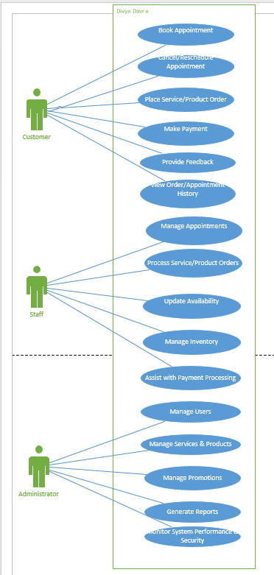
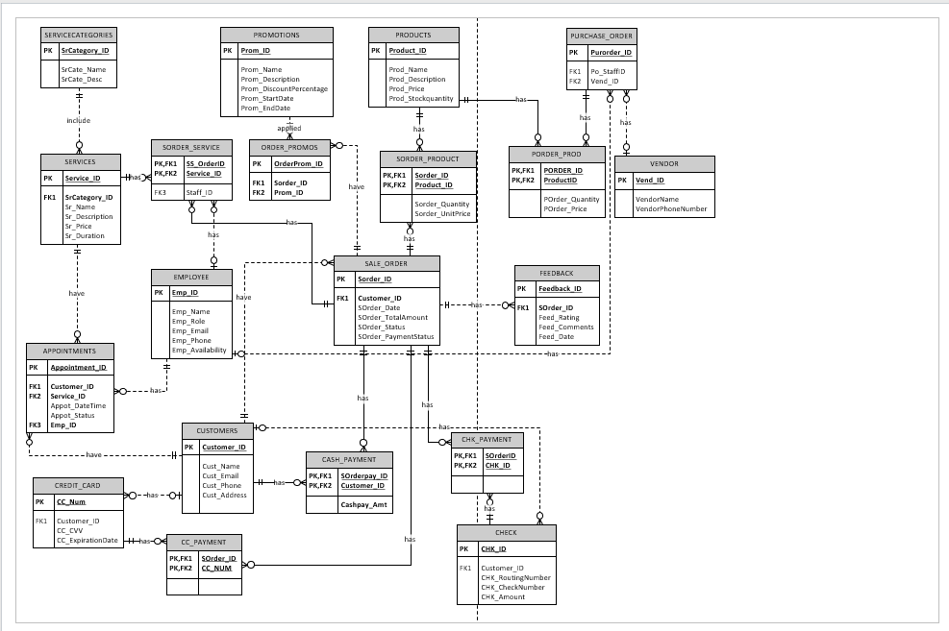
Appendices Screens Use Case Model for Service Management System and Entity Relationship Diagram (ERD)

Slide 14
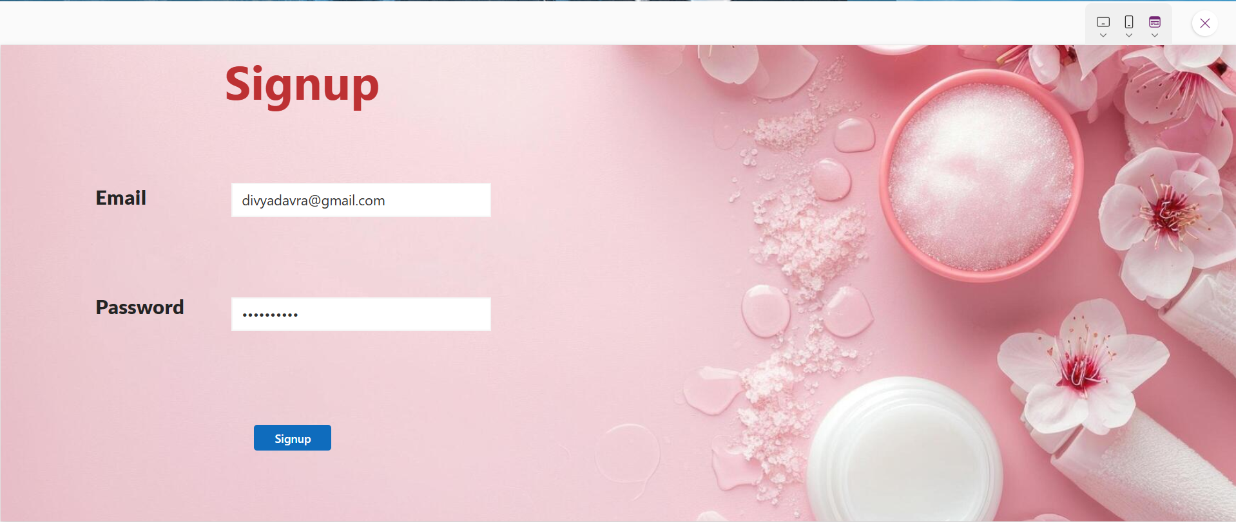
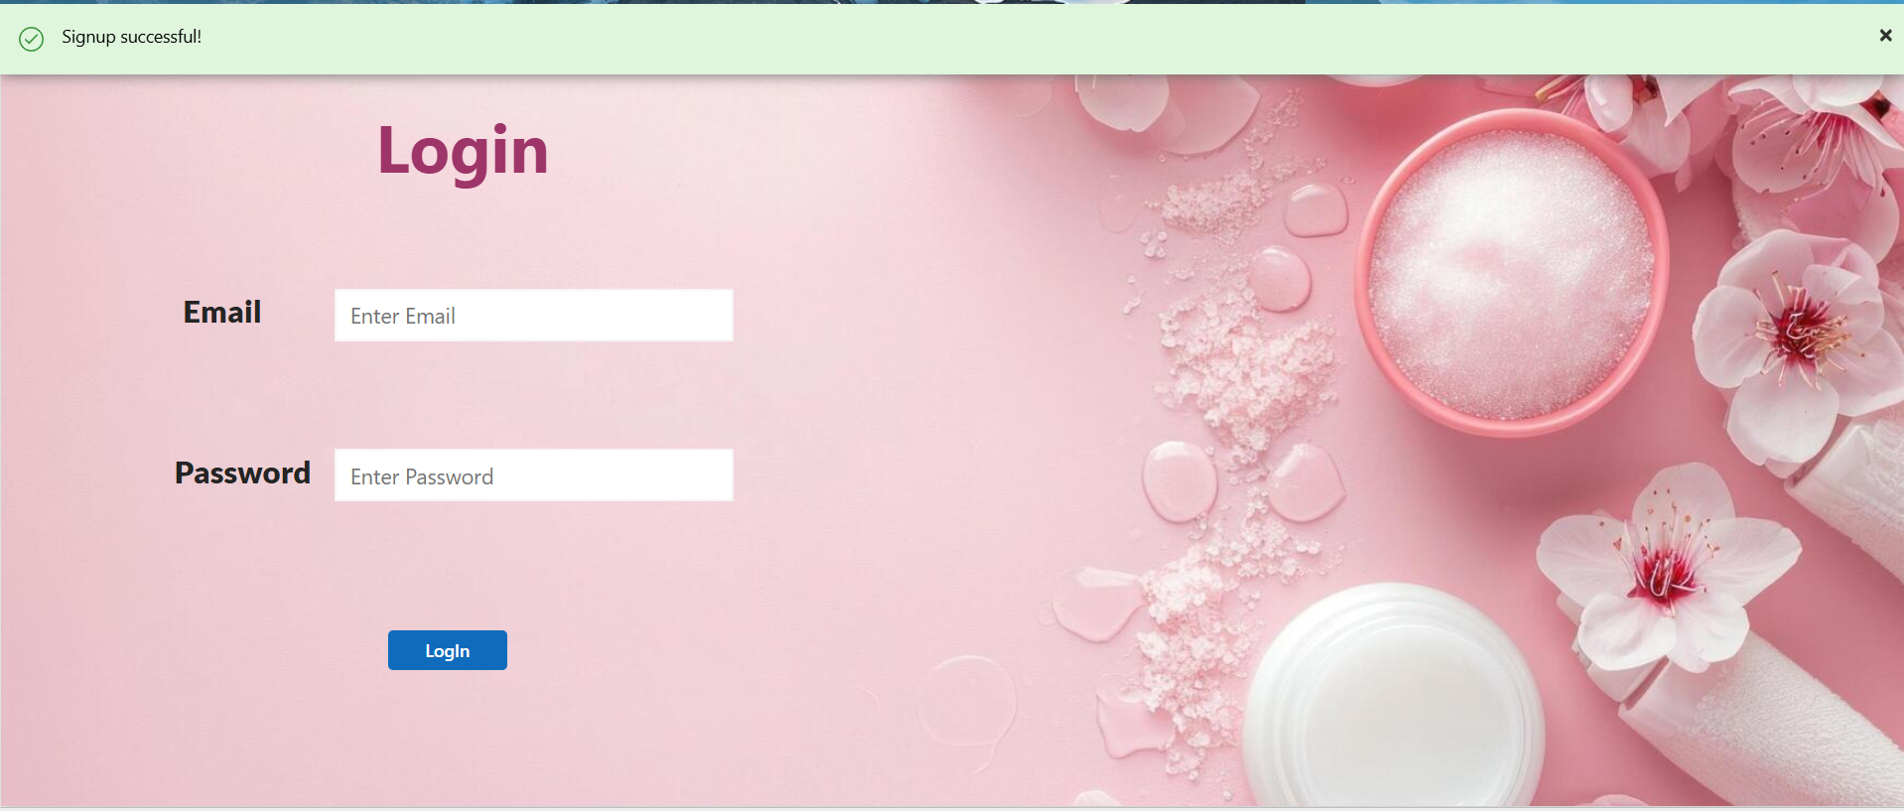
Prototype Screens – Signup & Login
Shows secure login interface for customers.

Slide 15

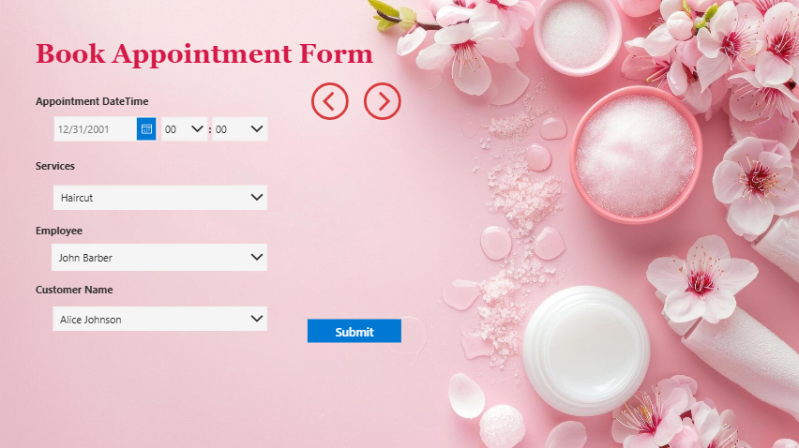
Main Screen – Beauty Salon Scheduler and Appointment Booking Interface

Slide 16
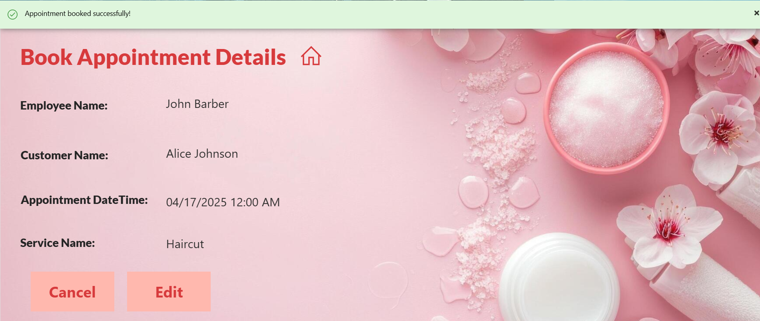
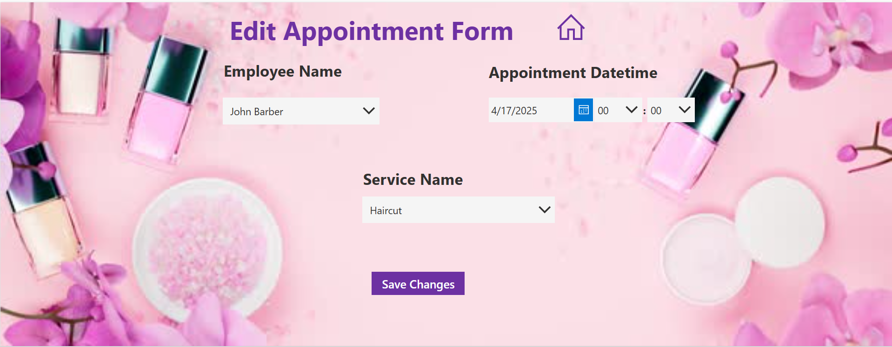
Book Appointment Details Screen and Edit Appointment Form Screen

Slide 17
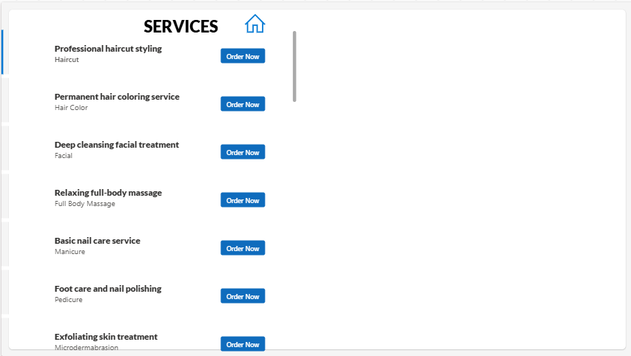
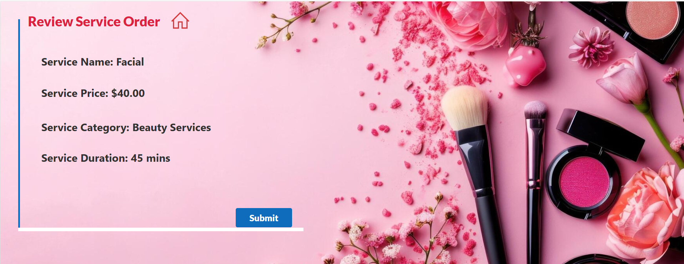
Service Order: Service Order Selection Screen and Review Service Order Screen

Slide 18
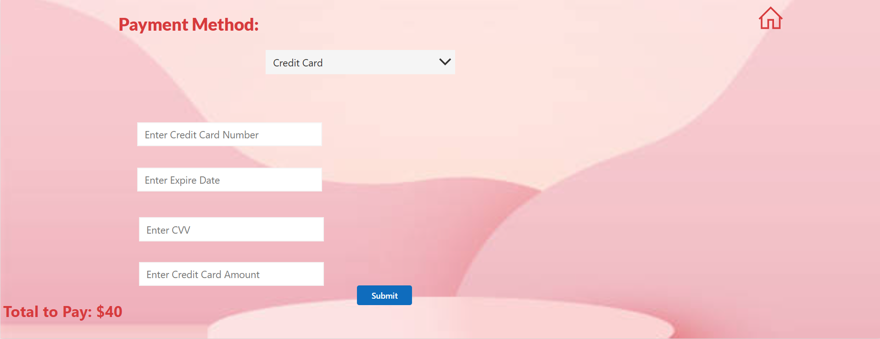
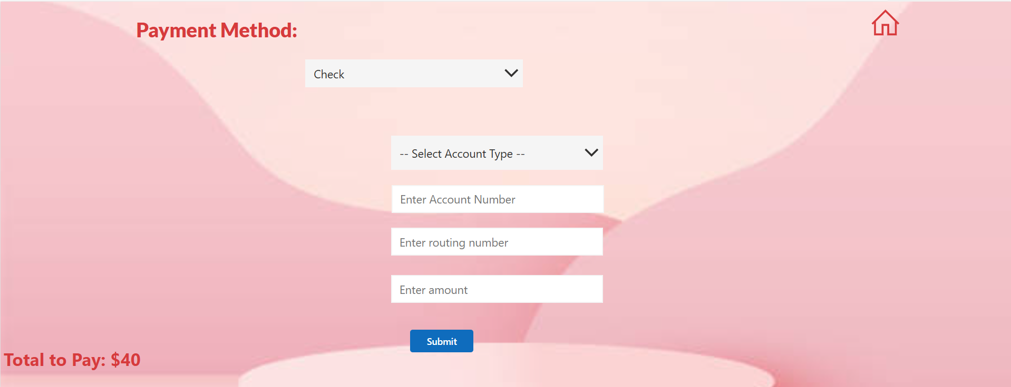
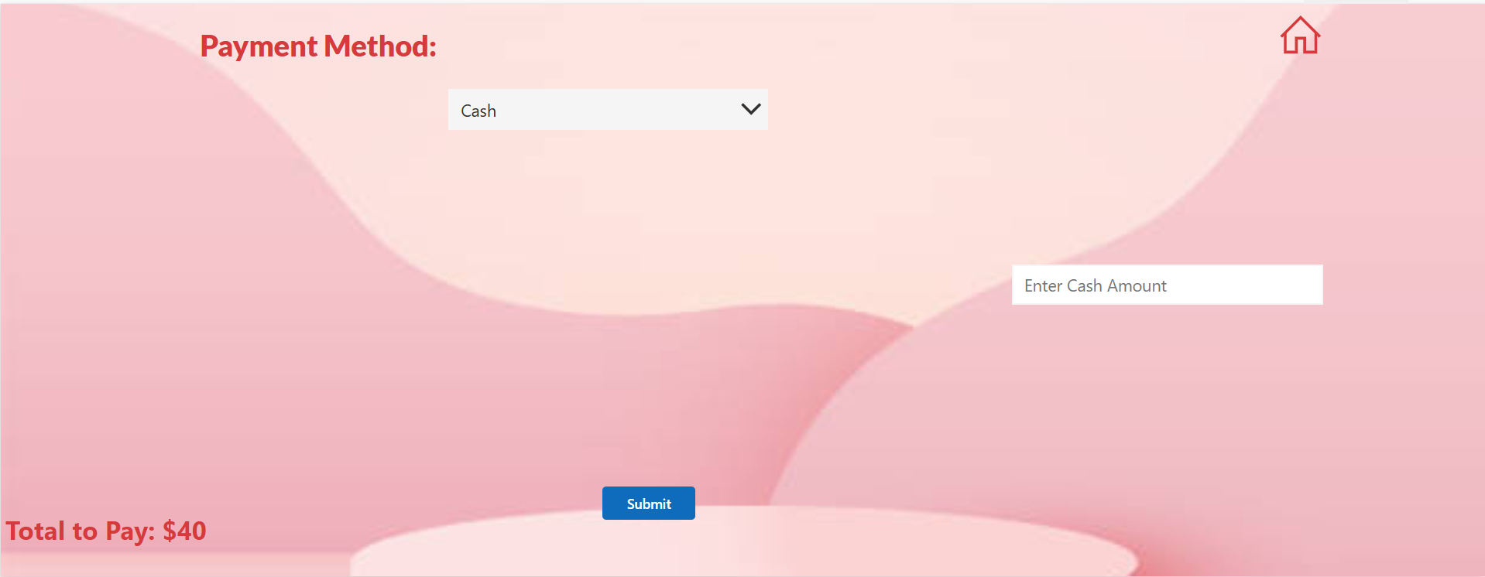
Payment Screens This screen enables customers to complete their payment using the selected method (Credit Card, Cash, or Check). The form dynamically displays relevant fields based on the payment option chosen.

Slide 19
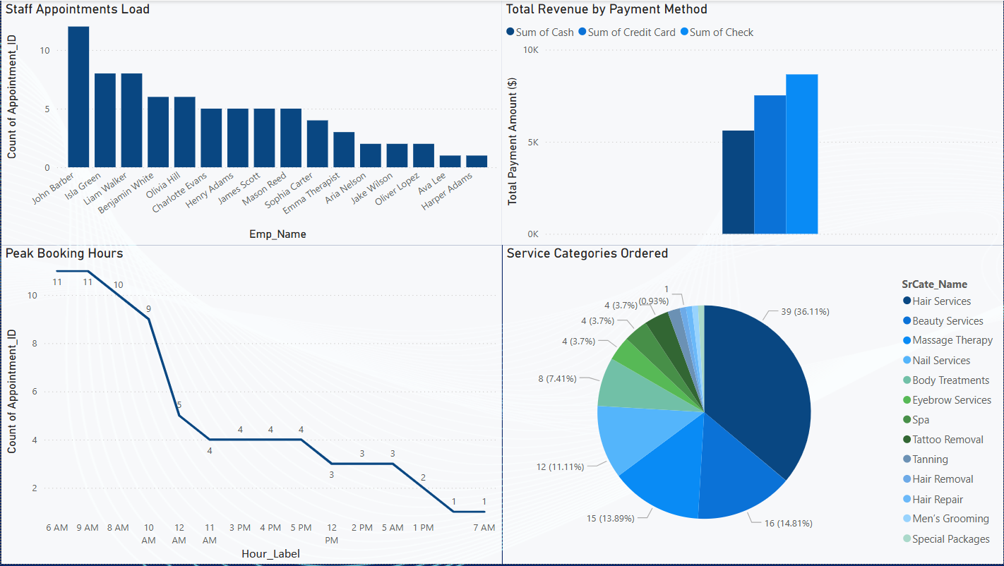
Admin Dashboard (Power BI) The Admin Dashboard provides a centralized, visual overview of key business metrics. It supports strategic decision-making with real-time insights and is developed in Microsoft Power BI. It contains four critical analytics charts:
Notes:
On the top-left, we have the Staff Appointments Load bar chart. It shows how many appointments each employee has handled—helping in balancing workloads.
The top-right chart shows Total Revenue by Payment Method—Cash, Credit Card, and Check—allowing the admin to see which method is most used.
At the bottom-left, the Peak Booking Hours line graph reveals customer booking trends throughout the day. This helps with smart staffing and resource planning.
And finally, the Service Categories Ordered pie chart shows which service types are most in demand, like Hair Services and Beauty Services.

Slide 20

Thank You

